Slide 2
An Integrated Working memory model for time-based resource-sharing
Joseph J. Glavan Joseph W. Houpt, Ph.D.
Wright State University
July 22, 2018
16th International Conference on Cognitive Modeling

Slide 3
Working Memory
Commonly thought of as a (passive?) store or sketchpad for holding and modifying information
Maintenance
Processing
The maintained information or other information
3 + 4 = 7
Notes:
The topic of my talk is working memory. I think we all have a general idea as to what that is. It is commonly thought of as a store or sketchpad for holding, and potentially manipulating, information over short periods of time.

Slide 4
Time-Based Resource-Sharing
WM is an active mechanism
Focuses attention on a single item for maintenance or processing
Focused item gains strength (activation)
All other items decay with time
More time for maintenance = more information retained
Less time for maintenance = less information retained
Barrouillet, Bernardin & Camos (2004)
Notes:
However the time based resource sharing, or TBRS, model, which I will talk about today, instead proposes that WM is an active mechanism that focuses attention on a single item at a time for either maintenance or processing, and this focused item gains strength or activation which makes it more likely to be recalled later.
Now, anything that is not currently in the focus of attention undergoes temporal decay and becomes harder to recall.
This means that the more time you have to use attention for maintenance, the more information that can be retained; whereas the less time time you have for maintenance, because attention is needed elsewhere, the less information that will be retained.

Slide 5
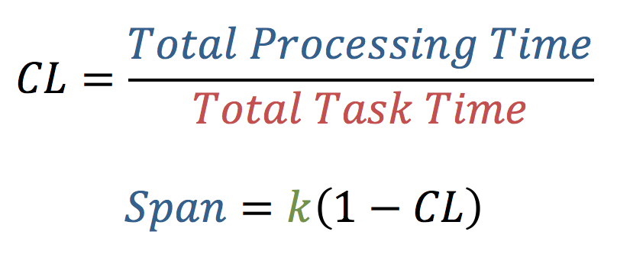
Cognitive Load
k = raw WM capacity (unique to individual, task, etc.)
Barrouillet, Portrat & Camos (2011)
Notes:
And if we divide the total processing time by the total task time, we get a proportion called cognitive load. TBRS predicts that observed WM span, or essentially the average number of items recalled, is a linear function of this CL.

Slide 6
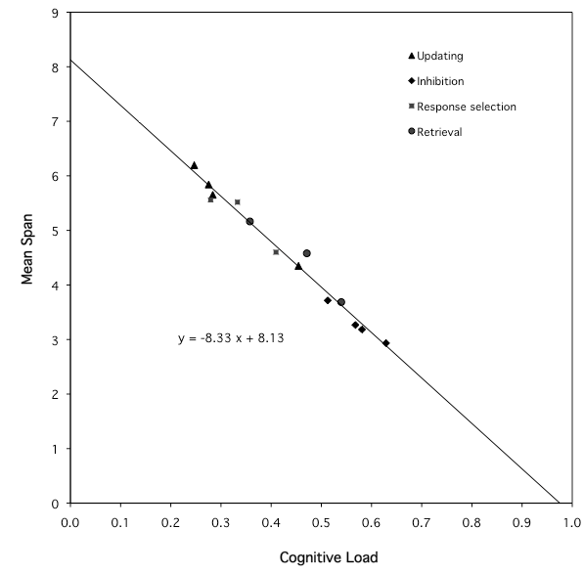
Y = -8.33 * X + 8.13
R² = .98
Barrouillet, Portrat & Camos (2011)
Notes:
Barrouillet, Camos, and colleagues have repeatedly demonstrated this linear function using a variety of distractor tasks. This figure here comes from a meta-analysis of 14 different conditions. What’s important is that this figure shows that the type of distractor task doesn’t affect how much information is retained, rather it is the temporal dynamics of the task that are important.

Slide 7
?
?
Barrouillet, Portrat & Camos (2011)

Slide 8
TWO MAINTENANCE MECHANISMS
Attentional refreshing
Executive loop / episodic buffer
Articulatory rehearsal
Articulatory loop / phonological store
Evidence for separate mechanisms
Orthogonal manipulation of
Concurrent task (CL)
Concurrent articulation (suppression)
Phonological similarity or word length
Additive (no interaction) effect on overall recall
Suppression removes PSE and WLE but CL alone doesn’t
Baddeley (2000); Camos & Barrouillet (2014)

Slide 9
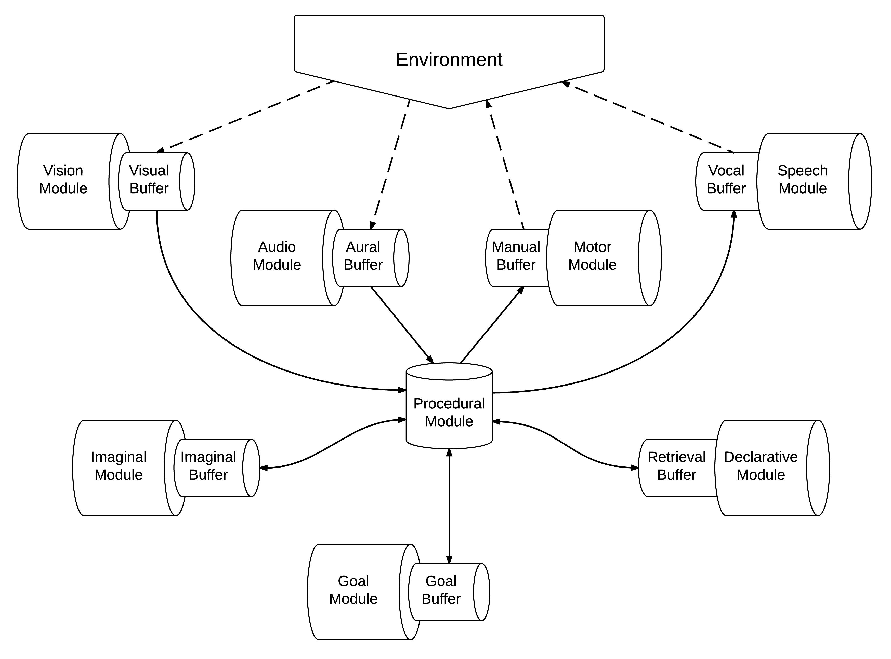
ACT-R
Anderson (2007)

Slide 10
TBRS and ACT-R are compatible
TBRS
ACT-R
Maintenance and processing both require attention
Central bottleneck
Temporal decay
Rapid switching between maintenance and processing
Limited capacity buffers
Only one production may fire at a time
Power law learning and forgetting (base-level learning)
Utility and production rule conditions to establish relative priority

Slide 11
Dual Task Paradigm
Maintenance
Processing
Episodic encoding
Attentional refreshing
Articulatory rehearsal
Attend to distractors
Retrieve necessary knowledge
Choose response
W | 7 | 9 | 6 | 6 | N | 8 | 2 | 2 | 7
S | 5 | 6 | 2 | 7 | L | 9 | 5 | 3 | 2
Notes:
Now let’s consider the dual task paradigm that is commonly used to study WM. You’re typically required to remember a list of some kind, in this case letters, while performing some distracting task, in this case reporting whether a number is odd or even. ((Example))
If we want to predict how much of the list will be recalled at the end, according to TBRS we need to consider how much time was available for maintenance. Now in practice it is often easier to consider how much time was unavailable for maintenance. In this case we can take a set of letters and treat the RT to each letter as a proxy for the distractor’s processing time. If we add up the RTs over a certain period of the task, we can calculate the total processing time.

Slide 12
Task expansion
Barrouillet, Bernardin, Portrat, Vergauwe & Camos (2007)

Slide 13
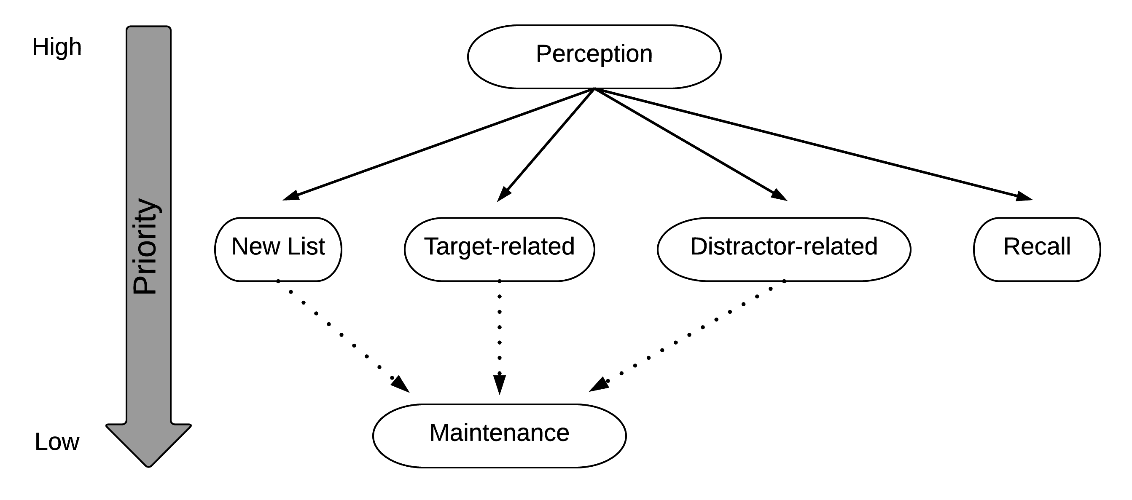
THE MODEL
Glavan (2017)

Slide 14
Parity Condition
Finish Encoding Number
Blind Guess Odd
Blind Guess Even
Retrieve Parity
Guess Odd
Guess Even
Retrieve Response Rule
Guess Odd
Guess Even
Respond According to Response Rule

Slide 15
Spatial Location Condition
Finish Encoding Number
Blind Guess Odd
Blind Guess Even
Guess Odd
Guess Even
Retrieve Response Rule
Respond According to Response Rule

Slide 16
THE MODEL
Glavan (2017)

Slide 17
Attentional refreshing
A
B
C
D
E
Glavan (2017)

Slide 18
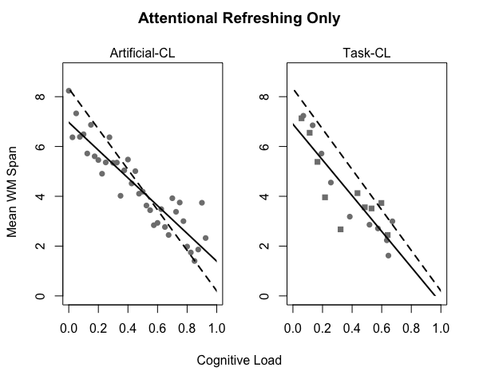
Model
Barrouillet et al. (2011)
Notes:
Here I’m plotting cognitive load on the x-axis and mean WM span on the y-axis. The left panel comes from using my artificial CL – remember that is when I prevent the model from being able to use refreshing for a certain amount of time. The right panel comes from using task-induced CL – that is when the model actually completes a distracting task, in this case parity or spatial judgments. The solid line is the model and the dashed line comes from the human regression that I showed you earlier.
The model does a good job of capturing the linear relationship, and the fit is closer for the task-based CL. Notice also that despite increasing the pace of the distractor task, the model does not produce CL above .7 or so. I’ll return to that in a moment.

Slide 19
Articulatory Rehearsal
Two parallel “loops”
Attentional refreshing (declarative retrievals) reactivates memory traces (episodic representations)
Articulatory loop (subvocalizing) operates on auditory representations
When both loops temporally align, auditory representation is used to cue retrieval
Symbolic cue is more robust than noisy, continuous-valued activation
Avoids temporal similarity penalty so that activation is greater
Notes:
I implement articulatory rehearsal by using two parallel loops: the attentional refreshing loop I just described actually does the work of boosting each item’s activation, while a second, articulatory or phonological loop, operates on auditory representations. This loop repeatedly pulls words the model recently heard from its aural buffer and then silently repeats it to itself, reloading the loop.
Although both loops may take different amounts of time to cycle, when they line up, as in when they both are ready retrieve or vocalize another item at the same time, the auditory representation is used as the retrieval cue for instead of the just-retrieved memory representation. This allows much weaker items to be retrieved because it avoids having to use the temporal similarity penalty.

Slide 20
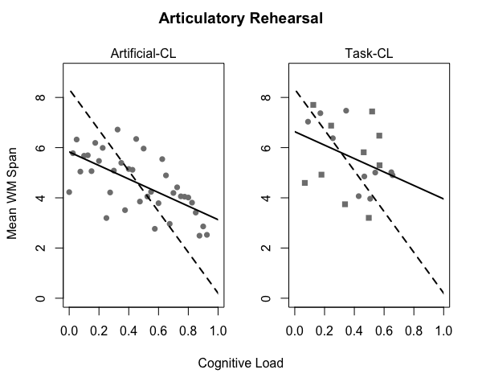
Model
Barrouillet et al. (2011)
Notes:
These are the results for the version of the model that uses articulatory rehearsal. There are two things to note about these figures. The first is that this version of the model is much more variable. The second is that the effect of CL has been reduced.
Another interesting feature of these results is that in the task-based CL condition, the model again refuses to produce CL greater than 0.7. If I color code these figures by the pace of the distractor task…

Slide 21
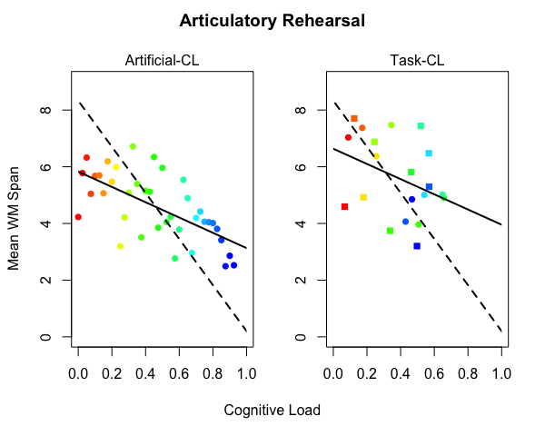
Model
Barrouillet et al. (2011)
Notes:
…so that the pace and therefore CL increases as the colors get colder, we can see that unexpectedly the fastest paces are not the furthest to the right, meaning that they do not yield the highest CL. What’s happening is that the model learns that it cannot reliably respond quick enough in this high-paced condition and begins to use a less accurate but faster strategy. What’s great is that the linear relationship between span and CL seems to still hold despite this change in strategy.

Slide 22
Discussion
Further support for linear relationship between WM span and CL
Better supported by refreshing-only version of the model
Might be non-linear but this could depend on delay/spacing
Articulatory rehearsal reduces the effect of CL
Might increase WM span in task-induced CL condition
Rehearsal itself induces some CL
Task-induced CL condition produces noisier results
Effect of temporal distribution of CL?
Model’s strategy is sensitive to CL manipulation
Relationship between WM span and CL is robust

Slide 23
Future Work
Continue exploring temporal dynamics of WM
Delay and spacing effects
Complex interactions between decay and refreshing
Applications to problem solving in real world work environments (Human Factors)
Build into the architecture (new module)
More sophisticated representations and association
Investigate articulatory suppression effects
Come check out my poster at CogSci on Friday!

Slide 24
Questions?
Anderson, J. R. (2007). How can the human mind occur in the physical universe? Oxford University Press.
Baddeley, A. (2000). The episodic buffer: A new component of working memory? Trends in Cognitive Sciences, 4(11), 417-423.
Barrouillet, P., Bernardin, S., & Camos, V. (2004). Time constraints and resource sharing in adults' working memory spans. Journal of Experimental Psychology: General, 133(1), 83.
Barrouillet, P., Bernardin, S., Portrat, S., Vergauwe, E., & Camos, V. (2007). Time and cognitive load in working memory. Journal of Experimental Psychology: Learning, Memory, and Cognition, 33(3), 570.
Barrouillet, P., Portrat, S., Camos, V. (2011). On the law relating processing to storage in working memory. Psychological Review, American Psychological Association, 118 (2), pp.175-92.
Camos, V., & Barrouillet, P. (2014). Attentional and non-attentional systems in the maintenance of verbal information in working memory: the executive and phonological loops. Frontiers in Human Neuroscience, 8, 900. doi:10.3389/fnhum.2014.00900
Glavan, J. J. (2017). Exploring the Time-Based Resource-Sharing model of working memory through computational modeling. (Unpublished master’s thesis). Wright State University. (http://rave.ohiolink.edu/etdc/view?acc_num=wright149609967802364)

Slide 25
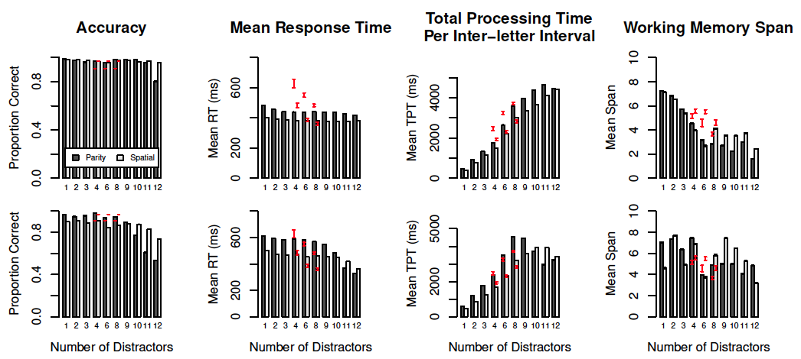
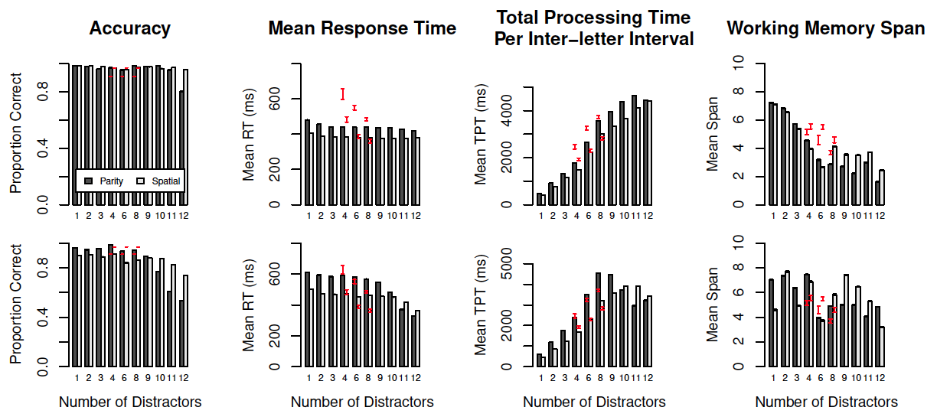
More Results

Slide 26
Attentional Refreshing
Retrieval Strategy
Request any target
Use just retrieved target as the cue for next request
Episodic Similarity
Association between targets which were encoded under similar temporal-contexts
Temporal Inhibition
Recently retrieved chunks are penalized
Glavan (2017)

Slide 27
Articulatory Rehearsal
If bottleneck is open, make a fresh retrieval
Continued Refreshing
If nothing in Aural buffer, then make another retrieval and
If Vocal module is free, then subvocalize the current item
If Aural buffer is full and Vocal module is free, then
If Declarative module is free then make a retrieval for and subvocalize the item in the Aural buffer
If Declarative module is busy then subvocalize the item in the Aural buffer

Slide 28
Span-CL function appears to hold across changes in strategy

Slide 29
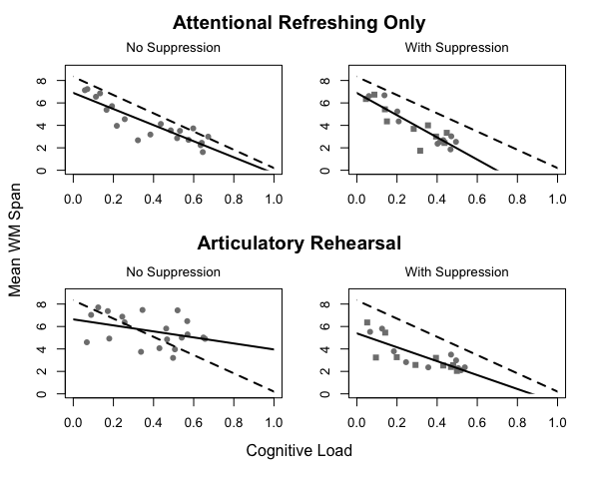

Slide 30
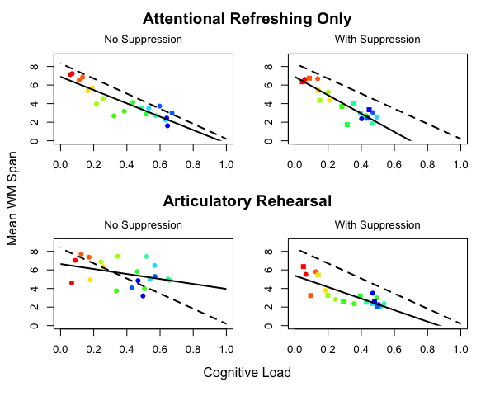

Slide 31
Articulatory Suppression
Additional subtask
Tone is played every 1 second during distractor subtask
When the tone is heard, say “ba”
Articulatory loop misses the tone
May just be an implementation limitation of ACT-R
Need more developed perceptual modules

Slide 32
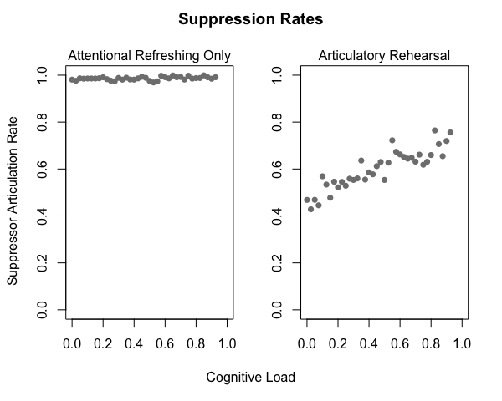

Slide 33
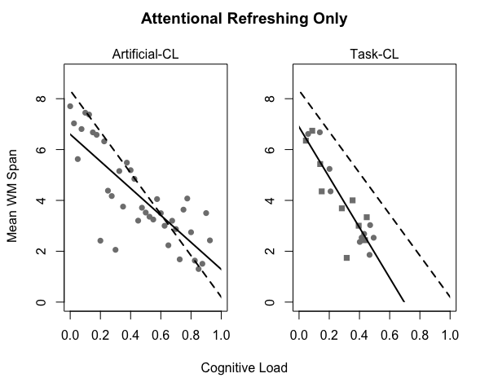

Slide 34
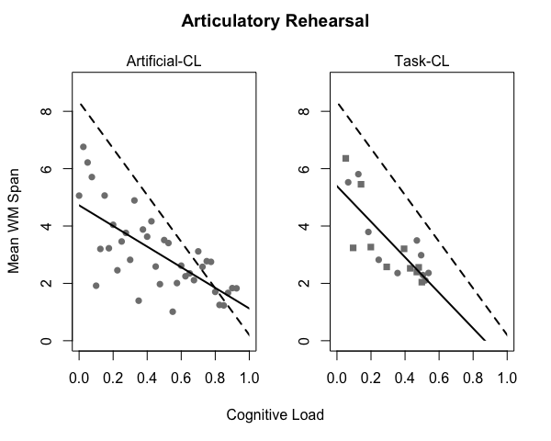

Slide 35
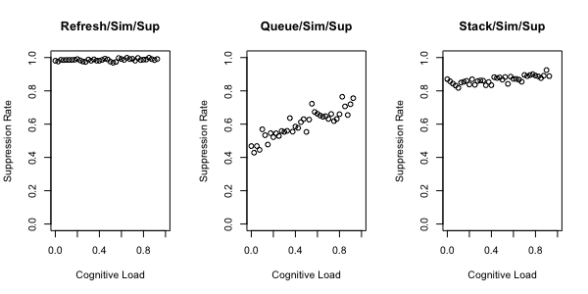

Slide 36
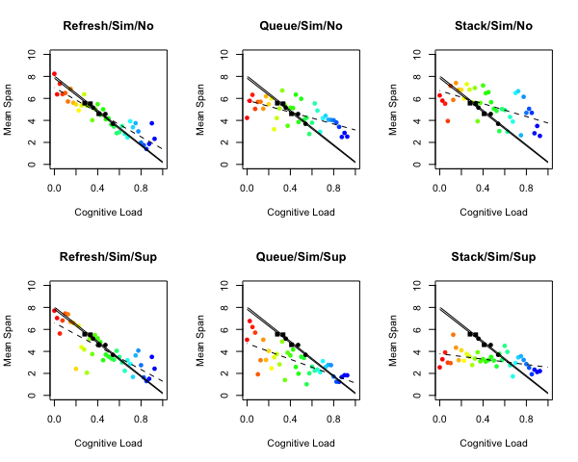

Slide 37
